Slide 1






Chapter 3 IP v4
Prof. Dr. Md. Samsuzzaman
Professor
Dept. Computer and Communication Engineering
Patuakhali Science and Technology University

Slide 2


Course Content :
Review of Previous Class
Background About Addressing
IP Addresses/ Logical Addressing
Types of IP Address
IPv4 Address
Address space
IP address Notation
Logical Operation of IP address
Types of IPv4 Address
Classful Addressing
Classless Addressing
Classful Address in details
Classes, level of addressing, subnet, network
Classless Address in details
Variable length block, Address allocation, subnet, network,
Special Address
IPv6 Address
IPv4 Issues
IPv6 Address Representation
IPv6 Types

Slide 3
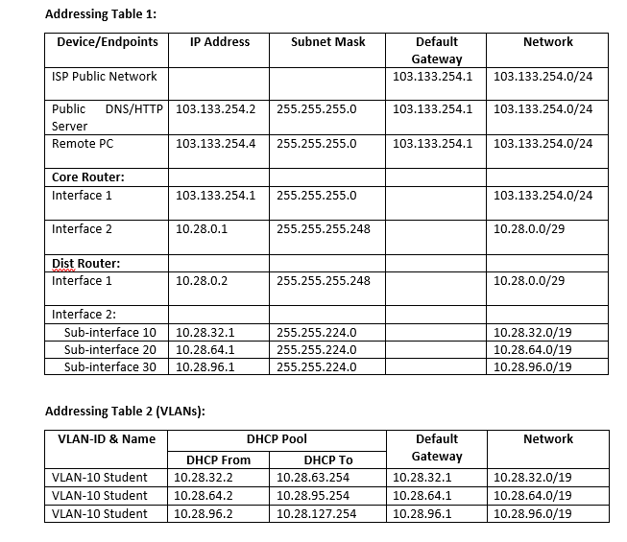
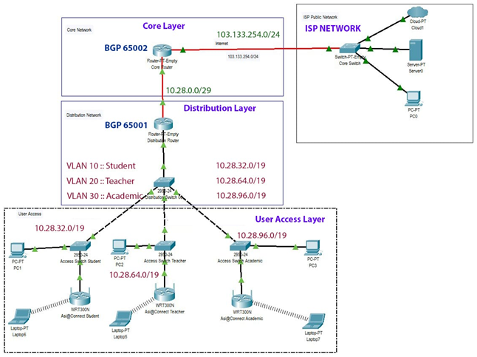
Campus Network IP Address

Slide 4
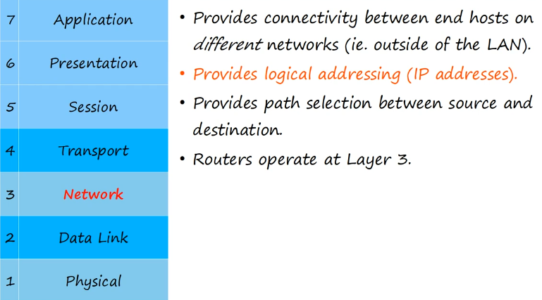
OSI Model (7)/ TCP IP Layer (5)

Slide 5
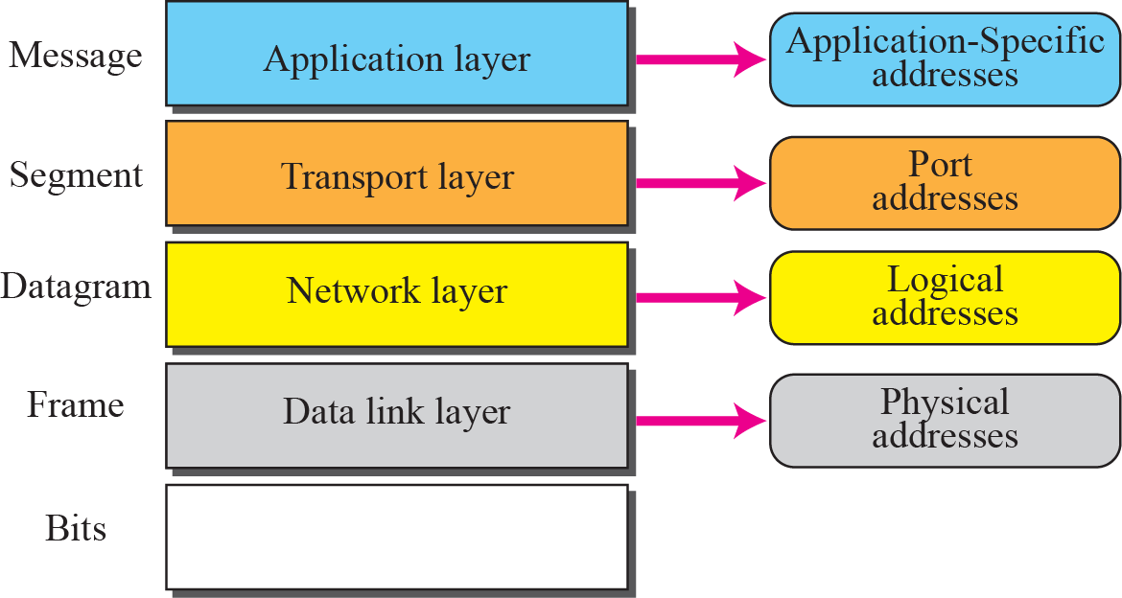
Addressing
Four levels of addresses are used in an internet employing the TCP/IP protocols: physical address, logical address, port address, and application-specific address. Each address is related to a one layer in the TCP/IP architecture, as shown in Figure.
Physical Addresses 07:01:02:01:2C:4B
Logical Addresses/IP Address 10.28.32.1
103.133.254.0/22
Port Addresses HTTP 80
Application-Specific Addresses techgirl@cse.pstu.ac.bd

Slide 6
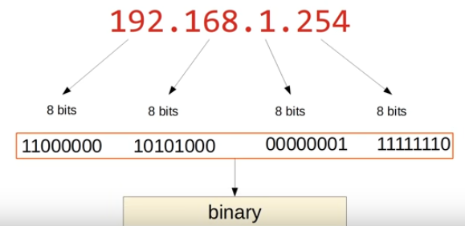
IP Addresses/ Logical Addressing
The identifier used in the IP layer of the TCP/IP protocol suite to identify each device connected to the Internet is called the Internet address or IP address.
An IP address is the address of the interface/NIC.

Slide 7
Types of IP Addresses/ Logical Addressing
Internet connected networks use two types of IP Addressing
– IPv4 – legacy Internet protocol
– IPv6 – new Internet protocol
2001:0DB8:0000:1111:0000:0000:0000:0200
FE80:0000:0000:0000:0123:4567:89AB:CDEF
IPv6 Address Representation
IPv4 Address Representation

Slide 8
IPv4 Addresses
An IPv4 address is a 32-bit address that uniquely and universally defines the connection of a host or a router to the Internet
An IPv4 address consists of four bytes (32 bits). These bytes are also known as octets.
--- . --- . --- . ---

Slide 9
Address Space
A protocol like IPv4 that deﬁnes addresses has an address space.
The address space of IPv4 is 2³² or 4,294,967,296.
0.0.0.0 through 255.255.255.255
00000000 00000000 00000000 00000000
.
.
111111111 111111111 111111111 111111111
Total of 32 bits
2 power 32 (2³²) 4 billion addresses

Slide 10
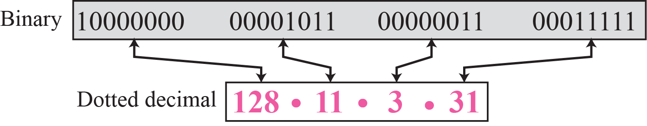
IP address Notation
a) Binary Notation: Base 2
01110101 10010101 00011101 11101010
b) Dotted-Decimal Notation: Base 256
c) Hexadecimal Notation: Base 16
0X810B0BEF or 810B0BEF₁₆

Slide 11
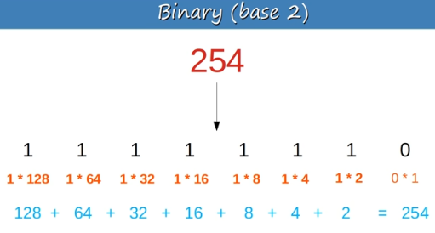
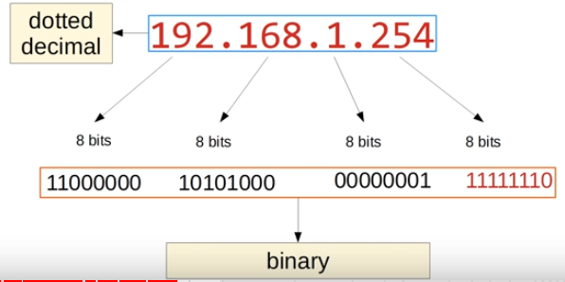
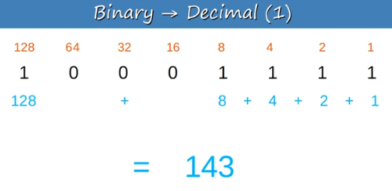
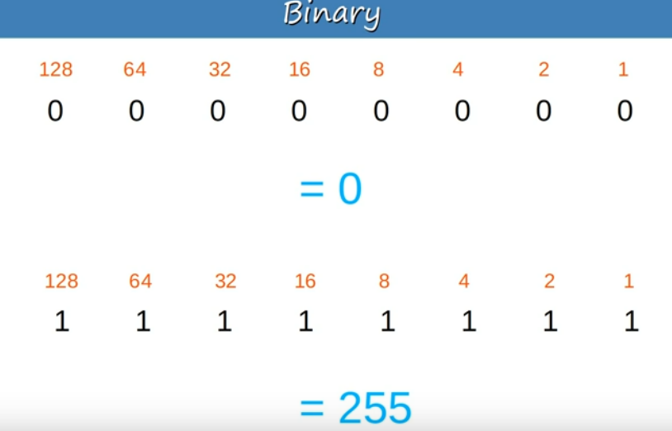
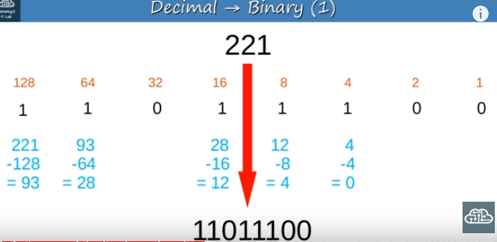
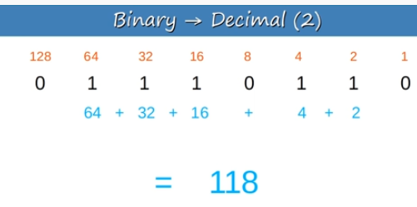
Address Notation

Slide 12
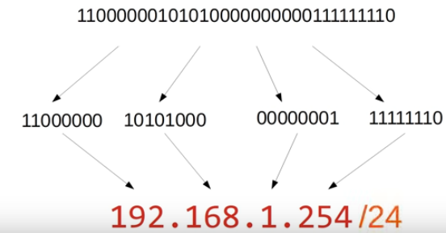
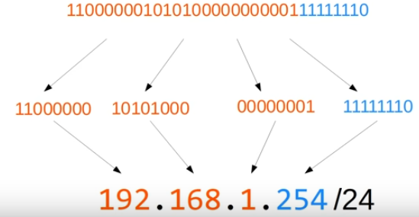
Address Notation

Slide 13
IPv4 Addresses
Change the following IPv4 addresses from binary notation to dotted-decimal notation.
a. 10000001 00001011 00001011 11101111
b. 11000001 10000011 00011011 11111111
c. 11100111 11011011 10001011 01101111
d. 11111001 10011011 11111011 00001111
Solution
We replace each group of 8 bits with its equivalent decimal number and add dots for separation:
a. 129.11.11.239
b. 193.131.27.255
c. 231.219.139.111
d. 249.155.251.15

Slide 14
IPv4 Addresses
Change the following IPv4 addresses from dotted-decimal notation to binary notation.
a. 111.56.45.78
b. 221.34.7.82
c. 241.8.56.12
d. 75.45.34.78
Solution
We replace each decimal number with its binary equivalent:
a. 01101111 00111000 00101101 01001110
b. 11011101 00100010 00000111 01010010
c. 11110001 00001000 00111000 00001100
d. 01001011 00101101 00100010 01001110

Slide 15
IPv4 Addresses
Find the error, if any, in the following IPv4 addresses:
a. 111.56.045.78
b. 221.34.7.8.20
c. 75.45.301.14
d. 11100010.23.14.67
Solution
a. There should be no leading zeroes (045).
b. We may not have more than 4 bytes in an IPv4 address.
c. Each byte should be less than or equal to 255.
d. A mixture of binary notation and dotted-decimal notation.

Slide 16
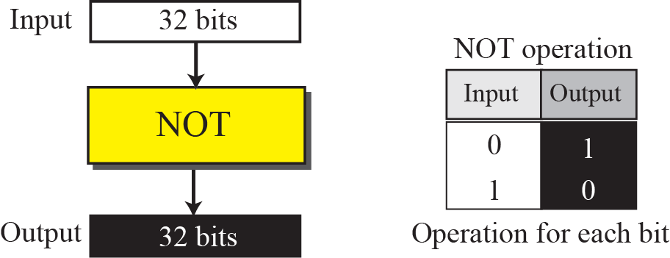
Logical Operation of IPv4 Addresses
Bitwise NOT operation

Slide 17
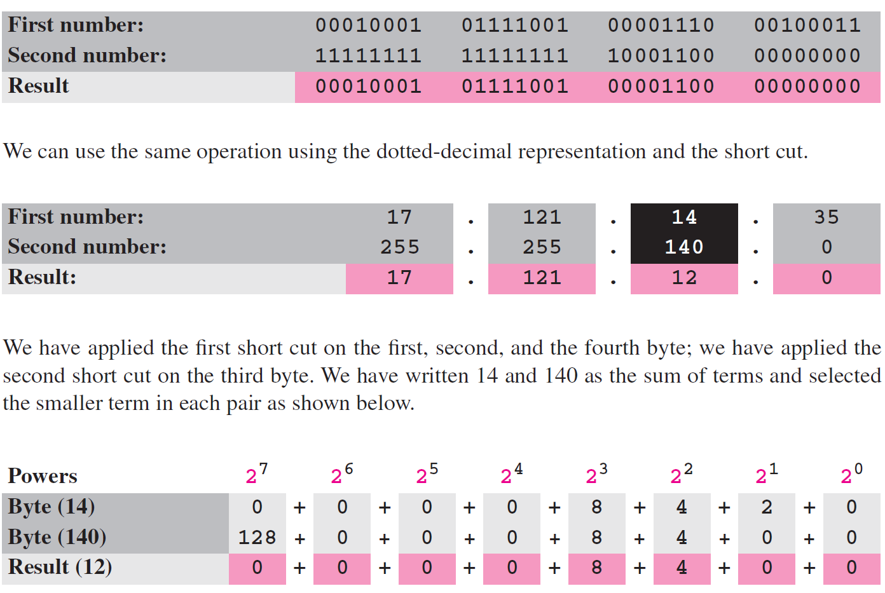
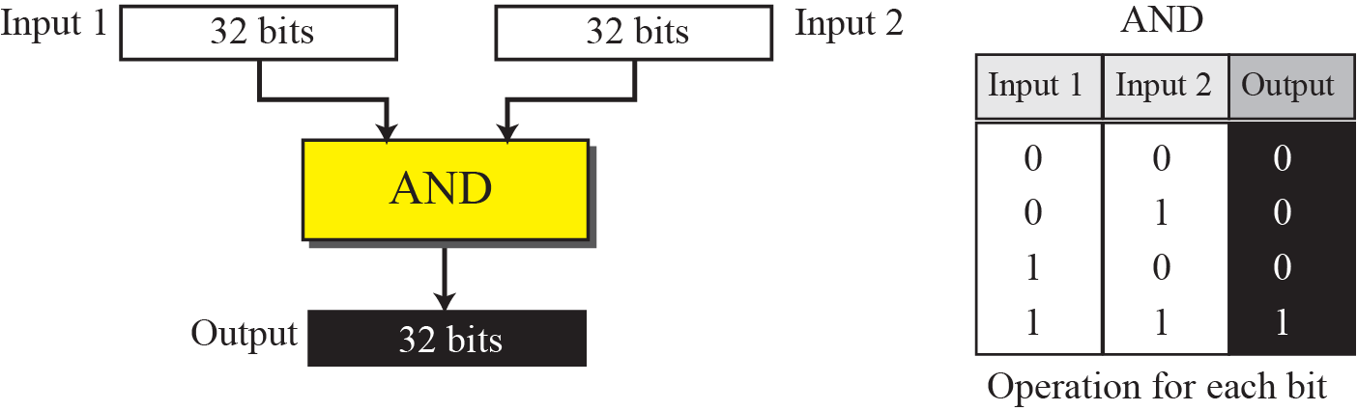
Logical Operation of IPv4 Addresses
Bitwise AND operation

Slide 18
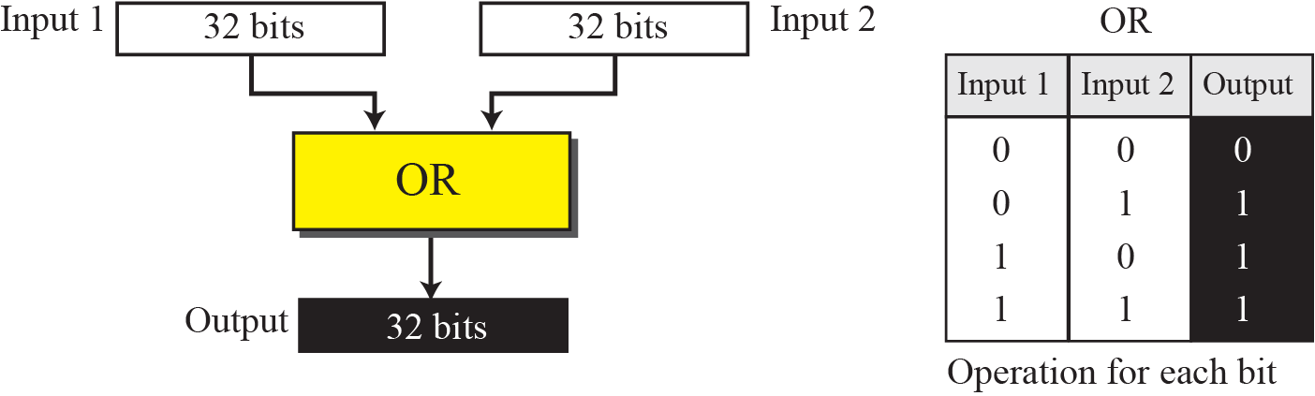
Logical Operation of IPv4 Addresses

Slide 19
Types of IPV4 Address
CLASSFUL ADDRESSING
IP addresses, when started a few decades ago, used the concept of classes. This architecture is called Classful addressing.
CLASSLESS ADDRESSING
In the mid-1990s, a new architecture, called classless addressing, was introduced that supersedes the original architecture.

Slide 20
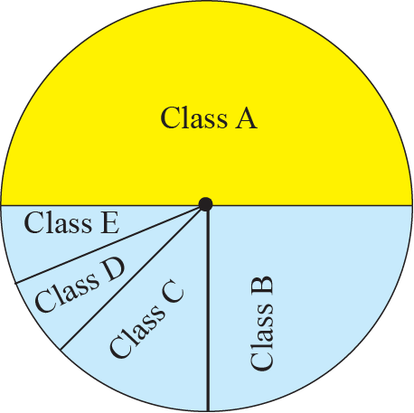
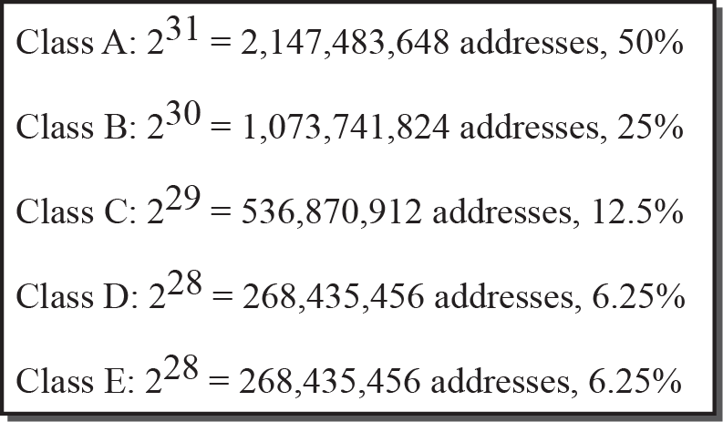
CLASSFUL ADDRESSING
In classful addressing, the IP address space is divided into ﬁve classes: A, B, C, D, and E.
Each class occupies some part of the whole address space.
Occupation of address space

Slide 21
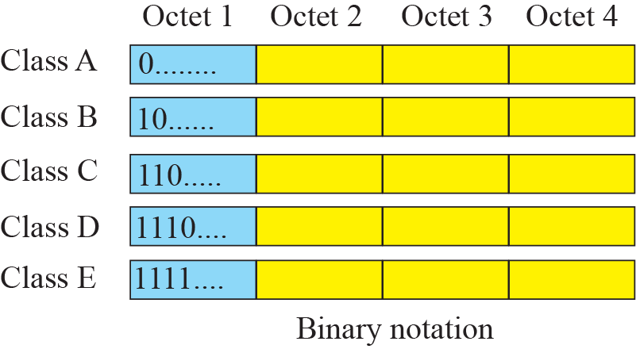
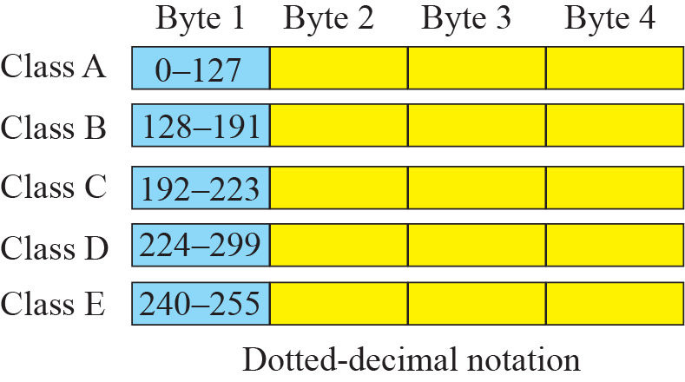
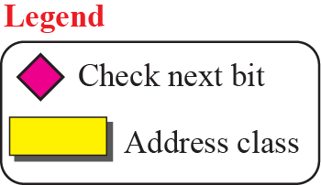
CLASSFUL ADDRESSING
Finding the class of address
239

Slide 22
Classful Addressing
Find the class of each address:
a. 227.12.14.87
b. 193.14.56.22
c. 14.23.120.8
d. 252.5.15.111
Solution
a. The first byte is 227 (between 224 and 239); the class is D.
b. The first byte is 193 (between 192 and 223); the class is C.
c. The first byte is 14 (between 0 and 127); the class is A.
d. The first byte is 252 (between 240 and 255); the class is E.

Slide 23
Classful Addressing
Netid and Hostid

Slide 24
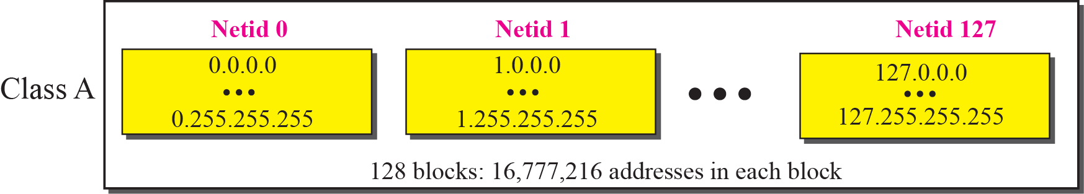
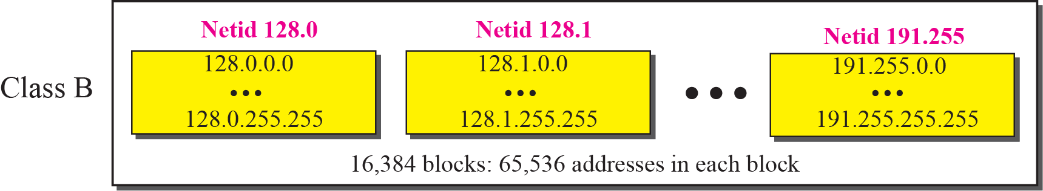
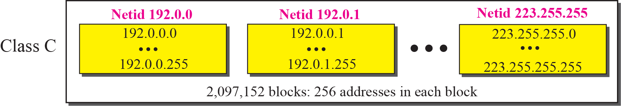
Classful Addressing
Classes and Blocks
Millions of class A addresses are wasted.
Many class B addresses are wasted.
Not so many organizations are so small to have a class C block.

Slide 25
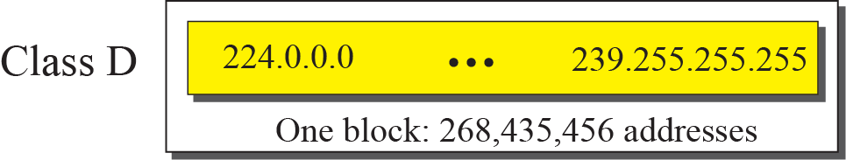
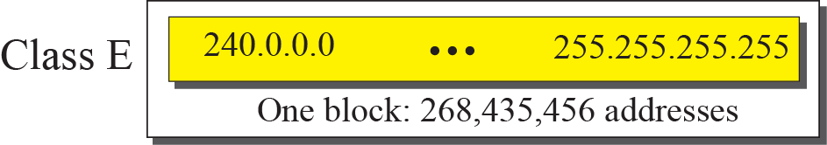
Classful Addressing
Classes and Blocks
Class D addresses are made of one block, used for multicasting.
The only block of class E addresses was reserved for future purposes.
The range of addresses allocated to an organization in classful addressing was a block of addresses in
Class A, B, or C.

Slide 26
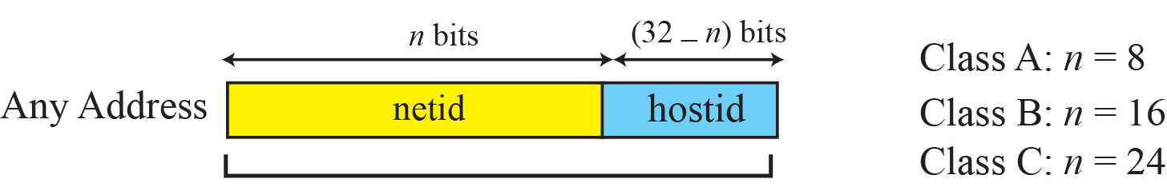
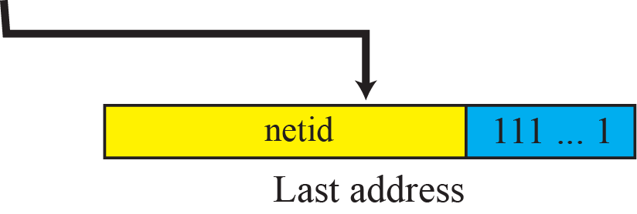
Classful Addressing
Two-Level Addressing

Slide 27
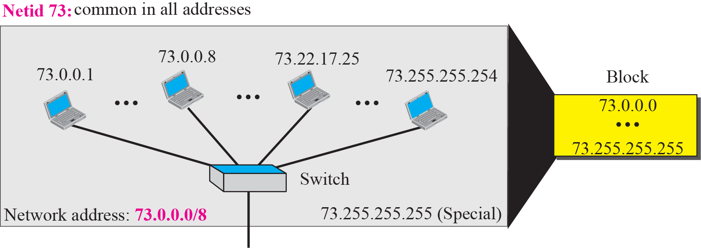
Classful Addressing
An address in a block is given as 73.22.17.25. Find the number of addresses in the block, the first address, and the last address.
Solution
Figure shows a possible configuration of the network that uses this block.
1. The number of addresses in this block is N = 2^{32−n} = 16,777,216.
2. To find the first address, we keep the leftmost 8 bits and set the rightmost 24 bits all to 0s. The first address is 73.0.0.0/8, in which 8 is the value of n.
3. To find the last address, we keep the leftmost 8 bits and set the rightmost 24 bits all to 1s. The last address is 73.255.255.255.

Slide 28
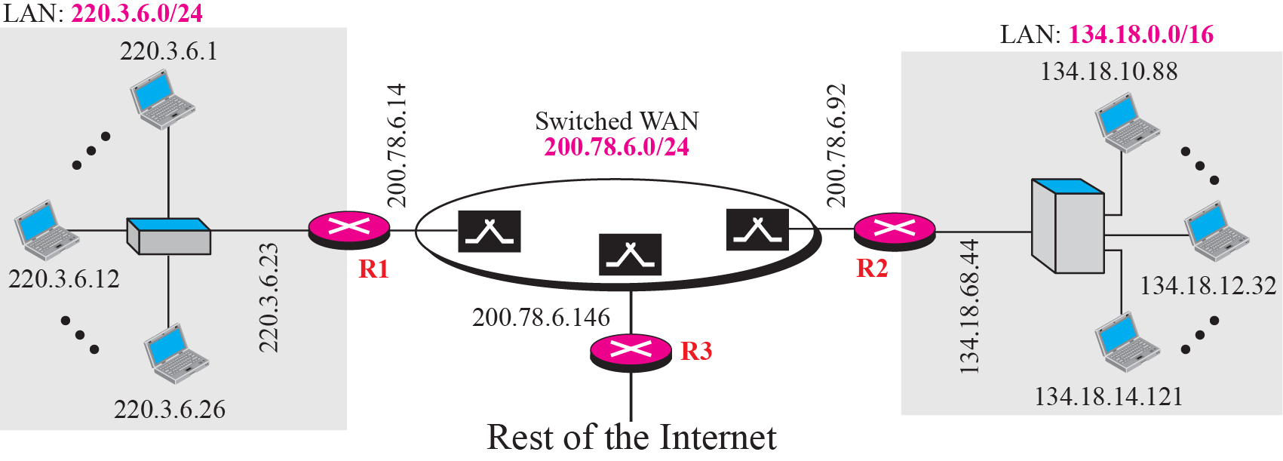
Classful Addressing (Sample Internet)

Slide 29
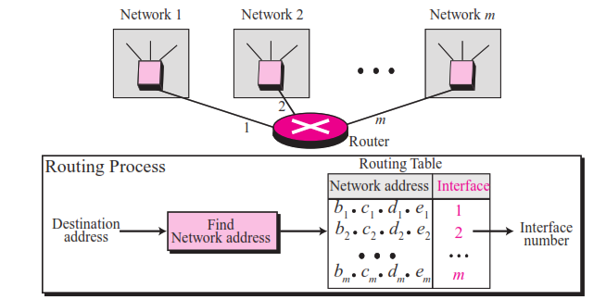
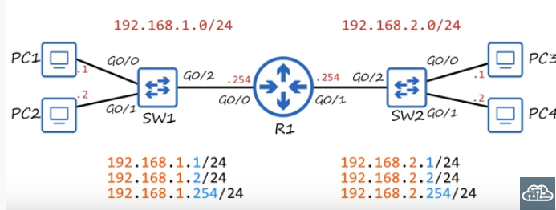
Network Address
The network address is the identiﬁer of a network.

Slide 30
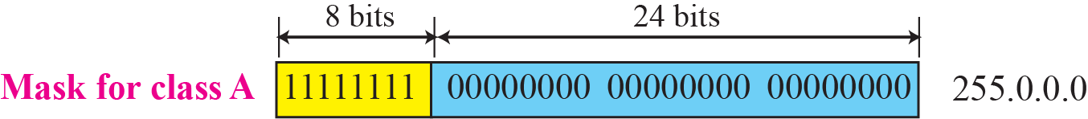
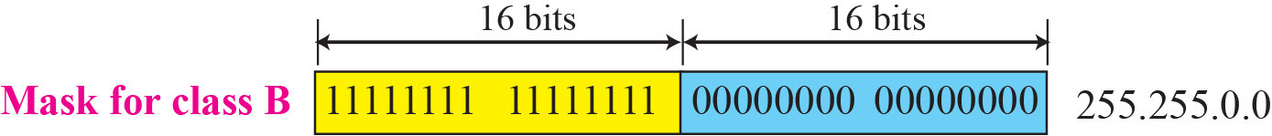
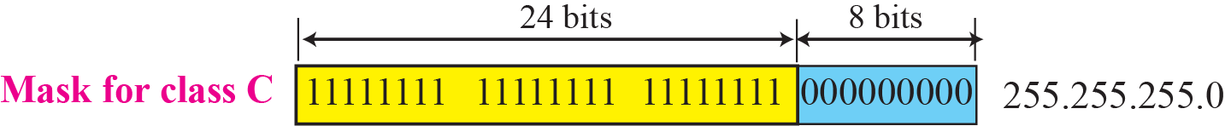
Network Mask (Default Mask)
It is called a subnet mask because it is used to identify network address of an IP address by perfoming a bitwise AND operation on the netmask.
A Subnet mask is a 32-bit number that masks an IP address, and divides the IP address into network address and host address.

Slide 31
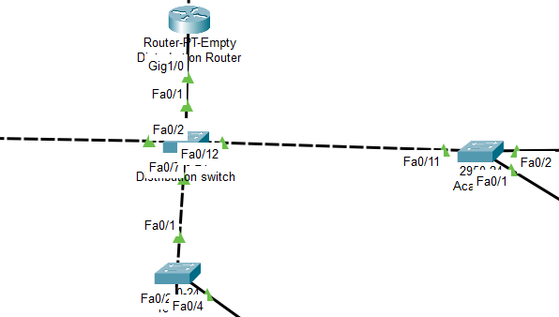
Classful Addressing
A router receives a packet with the destination address 201.24.67.32. Show how the router finds the network address of the packet.
Solution
Since the class of the address is C, we assume that the router applies the default mask for class C, 255.255.255.0 to find the network address.

Slide 32
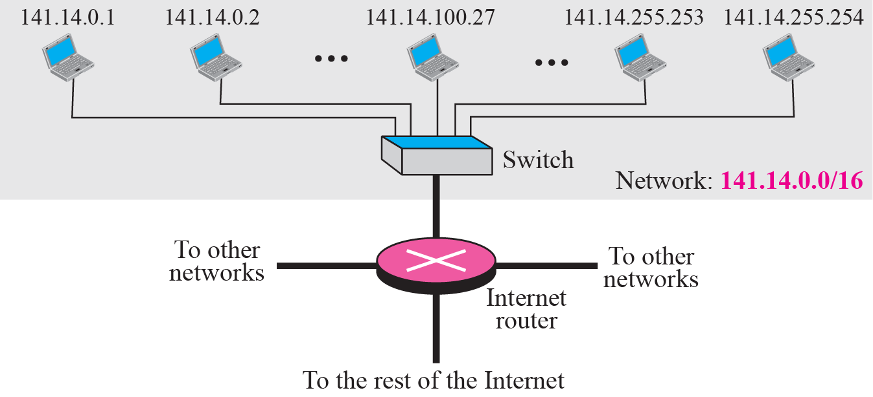
Classful Addressing
Three-Level Addressing: Subnetting
The idea of splitting a block to smaller blocks is referred to as subnetting.
In subnetting, a network is divided into several smaller subnetworks (subnets) with each subnetwork having its own subnetwork address.
A network using class B addresses before subnetting.

Slide 33
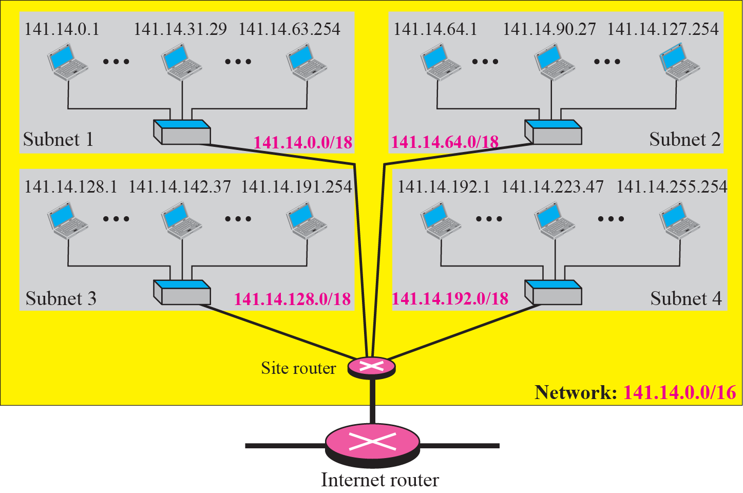
Classful Addressing (Subnetting)

Slide 34
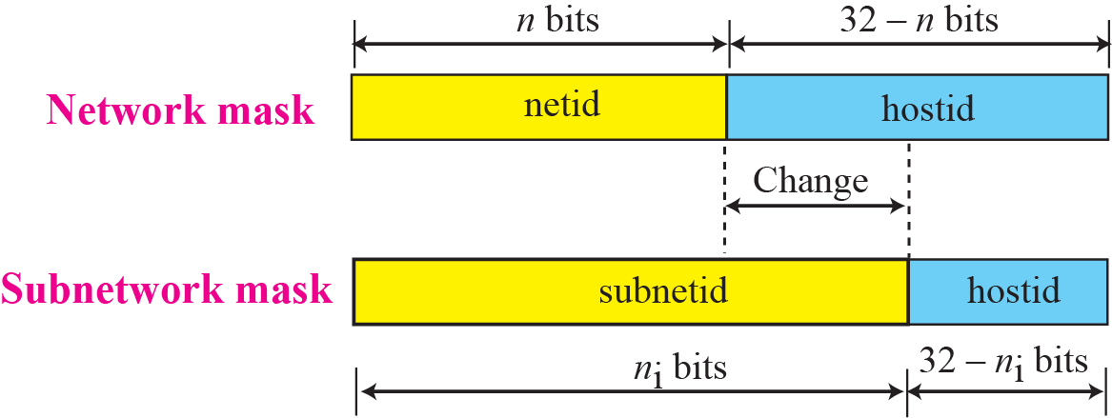

Classfull Addressing (Subnetting)
The network mask is used when a network is not subnetted.
When we divide a network to several subnetworks, we need to create a subnetwork mask (or subnet mask) for each subnetwork.
A subnetwork has subnetid and hostid

Slide 35
Classfull Addressing (Subnetting)
In previous example we divided a class B network into four subnetworks. The value of n = 16 and the value of
n₁ = n₂ = n₃ = n₄ = 16 + log₂4 = 18.
This means that the subnet mask has eighteen 1s and fourteen 0s. In other words, the subnet mask is 255.255.192.0 which is different from the network mask for class B (255.255.0.0).

Slide 36
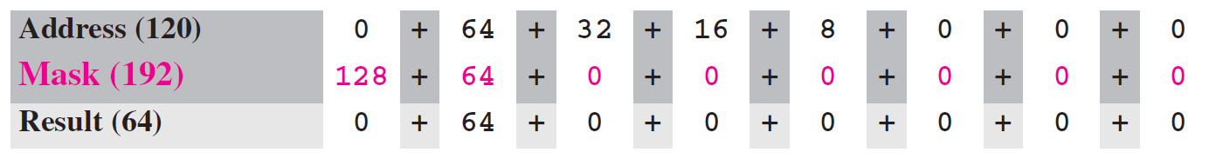
Classfull Addressing
In Previous Example , we show that a network is divided into four subnets. Since one of the addresses in subnet 2 is 141.14.120.77, we can find the subnet address as:
The values of the first, second, and fourth bytes are calculated using the first short cut for AND operation. The value of the third byte is calculated using the second short cut for the AND operation.

Slide 37
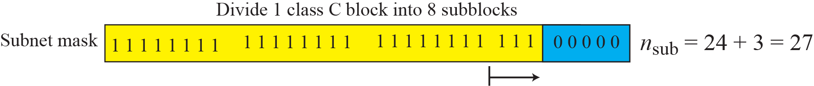
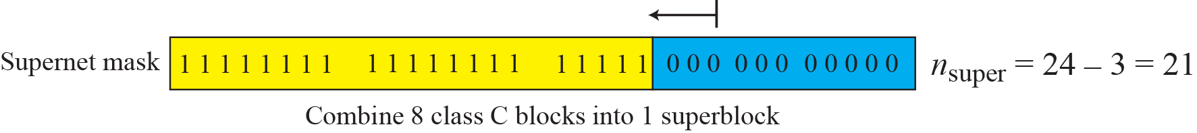
Classful Addressing
Comparison of subnet, default, and supernet mask

Slide 38
Classless Addressing
Subnetting and supernetting in classful addressing did not really solve the address depletion problem.
With the growth of the Internet, it was clear that a larger address space was needed as a long-term solution.
The short-term solution still uses IPv4 addresses, but it is called classless addressing.

Slide 39
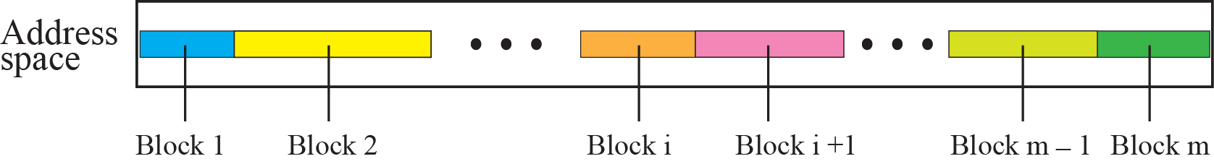
Classless Addressing
Variable-Length Blocks
In classless addressing, the whole address space is divided into variable length blocks.
Theoretically, we can have a block of 2 addresses.
The only restrictionis that the number of addresses in a block needs to be a power of 2.
An organization can be granted one block of addresses.

Slide 40
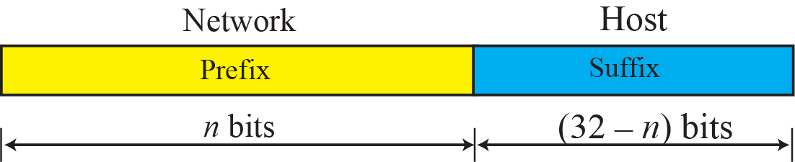
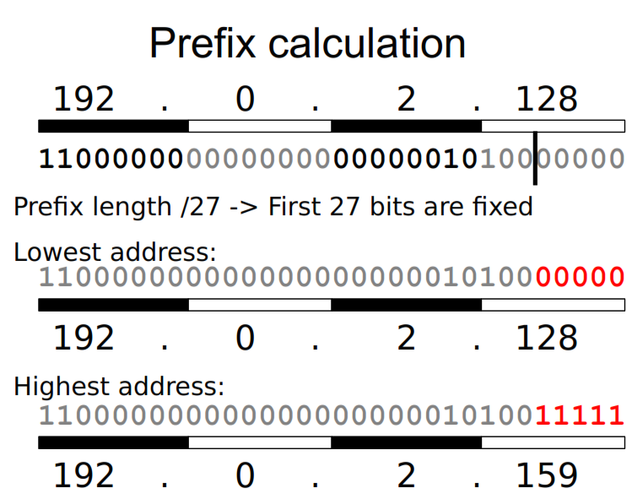
Classless Addressing
Two-Level Addressing
In classless addressing, the preﬁx deﬁnes the network and the sufﬁx deﬁnes the host.
All addresses in the block have the same preﬁx; each address has a different sufﬁx.
The preﬁx length in classless addressing can be 1 to 32.

Slide 41
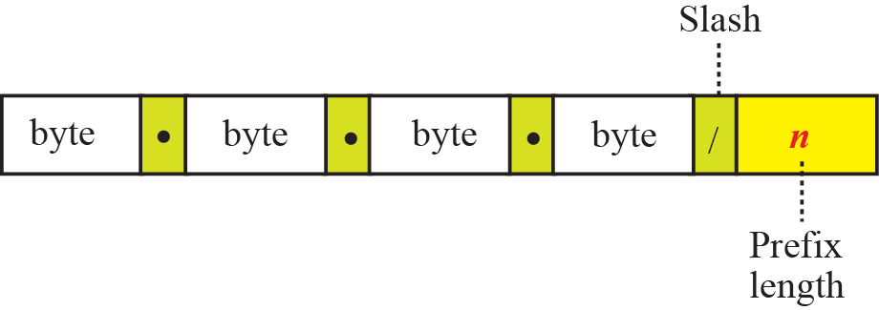
Classless Addressing
Slash Notation
In classful addressing, the netid length is inherent in the address. Given an address, we know the class of the address that allows us to ﬁnd the netid length (8, 16, or 24).
In classless addressing, the preﬁx length cannot be found if we are given only an address in the block. The given address can belong to a block with any preﬁx length.
10.28.0.0/29
In classless addressing, we need to know one of the addresses in the block and the preﬁx length to deﬁne the block.
The slash notation is formally referred to as classless interdomain routing or CIDR (pronounced cider) notation.

Slide 42
Classless Addressing
Network Mask
The idea of network mask in classless addressing is the same as the one in classful addressing.
A network mask is a 32-bit number with the n leftmost bits all set to 1s and the rest of the bits all set to 0s.
10.28.0.0/29 n=29
Network address
255.255.255.248
Network Mask/Subnet Mask
1111111 1111111 1111111 11111000
29 32-29=3

Slide 43
Classless Addressing
The following addresses are defined using slash notations.
a. In the address 12.23.24.78/8, the network mask is 255.0.0.0. The mask has eight 1s and twenty-four 0s. The prefix length is 8; the suffix length is 24.
b. In the address 130.11.232.156/16, the network mask is 255.255.0.0. The mask has sixteen 1s and sixteen 0s.The prefix length is 16; the suffix length is 16.
c. In the address 167.199.170.82/27, the network mask is 255.255.255.224. The mask has twenty-seven 1s and five 0s. The prefix length is 27; the suffix length is 5.

Slide 44
Classless Addressing
One of the addresses in a block is 17.63.110.114/24. Find the number of addresses, the first address, and the last address in the block.
Solution
The network mask is 255.255.255.0.
a. The number of addresses in the network is 2³² ⁻ ²⁴ = 256.
b. To find the first address, we use the short cut methods discussed early in the chapter. The first address is 17.63.110.0/24.
c. To find the last address, we use the complement of the network mask and the first short cut method we discussed before. The last address is 17.63.110.255/24.

Slide 45
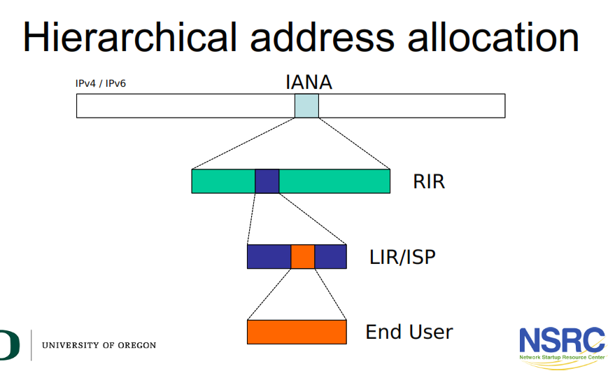
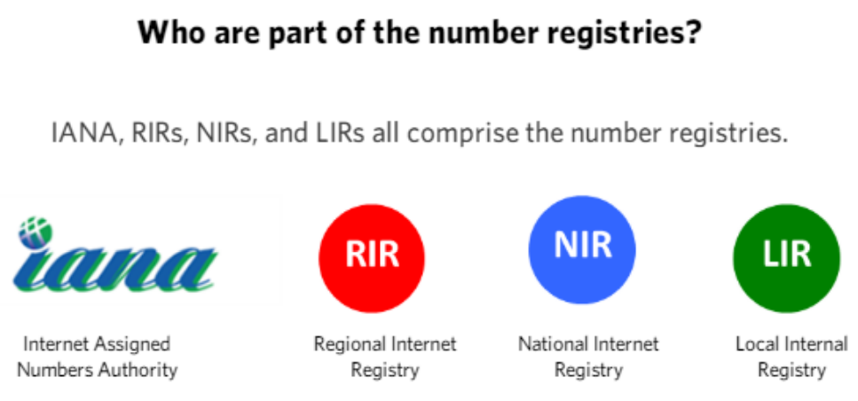


Internet Address Allocation
Notes:
Internet Corporation for Assigned Names and Addresses (ICANN).
Internet Assigned Numbers Authority (IANA)

Slide 46

Classless Addressing
Block Allocation
The ultimate responsibility of block allocation is given to a global authority called ICANN
For the proper operation of the CIDR, three restrictions need to be applied to the allocated block.

Slide 47
Classless Addressing
An ISP has requested a block of 1000 addresses. The following block is granted.
a. Since 1000 is not a power of 2, 1024 addresses are granted (1024 = 2¹⁰).
b. The prefix length for the block is calculated as n = 32 − log₂¹⁰²⁴ = 22.
c. The beginning address is chosen as 18.14.12.0 (which is divisible by 1024).
The granted block is 18.14.12.0/22. The first address is 18.14.12.0/22 and the last address is 18.14.15.255/22.

Slide 48

Classless Addressing (Subnetting)
An organization (or an ISP) that is granted a range of addresses may divide the range into several subranges and assign each subrange to a subnetwork (or subnet).
Following steps need to be carefully followed to guarantee the proper operation of the subnetworks.
The total number of addresses granted to the organization is N, the prefix length is n, the assigned number of addresses to each subnetwork is Nsub, the prefix length for each subnetwork is nsub, and the total number of subnetworks is s
1. The number of addresses in each subnetwork should be a power of 2.
2. The preﬁx length for each subnetwork should be found using the following formula:
3. The starting address in each subnetwork should be divisible by the number of addresses in that subnetwork. This can be achieved if we ﬁrst assign addresses to larger networks.

Slide 49
Classless Addressing
Address Aggregation
One of the advantages of CIDR architecture is address aggregation. ICANN assigns a large block of addresses to an ISP. Each ISP in turn divides its assigned block into smaller subblocks and grants the subblocks to its customers; many blocks of addresses are aggregated in one block and granted to one ISP.
Example
An BTCL is granted a block of addresses starting with 190.100.0.0/16 (65,536 addresses).
The ISP needs to distribute these addresses to three groups of customers as follows:
❑ The Dhaka group has 64 customers; each needs approximately 256 addresses.
❑The Barishal group has 128 customers; each needs approximately 128 addresses.
❑ The Khulna group has 128 customers; each needs approximately 64 addresses.
We design the subblocks and find out how many addresses are still available after these allocations.

Slide 50
Classless Addressing
Solution
Let us solve the problem in two steps. In the first step, we allocate a subblock of addresses to each group. The total number of addresses allocated to each group and the prefix length for each subblock can found as
Figure 1 shows the design for the first hierarchical level. Figure 2 shows the second level of the hierarchy. Note that we have used the first address for each customer as the subnet address and have reserved the last address as a special address.

Slide 51

Classless Addressing
Solution to Example first step

Slide 52



Classless Addressing

Slide 53
SPECIAL ADDRESSES
In classful addressing some addresses were reserved for special purposes. The classless addressing scheme inherits some of these special addresses from classful addressing.
All-Zeros Address : The block 0.0.0.0/32
All-Ones Address: Limited Broadcast Address
The block 255.255.255.255/32
Loopback Addresses
The block 127.0.0.0/8 is used for the loopback address, which is an address used to test the software on a machine

Slide 54



Unicast Multicast and Broadcast

Slide 55
SPECIAL ADDRESSES
Private Addresses/Local Address
A number of blocks are assigned for private use. They are not recognized globally.
Multicast communication
224.0.0.0/4 is reserved for multicast communication.

Slide 56

SPECIAL ADDRESSES
Special Addresses in Each block
Network Address
The have already discussed network addresses. The ﬁrst address (with the sufﬁx set all to 0s) in a block deﬁnes the network address.
10.28.0.0/29
Direct Broadcast Address
The last address in a block or subblock (with the sufﬁx set all to 1s) can be used as a direct broadcast address. This address is usually used by a router to send a packet to all hosts in a speciﬁc network.

Slide 57



Important Notes
https://www.auvik.com/resources/subnet-calculator/

Slide 58




Quiz

Slide 59

Designing an Address Plan IPv4
The following table shows the host allocation for each part of that campus
The University has the following address space: – 172.16.0.0/16 IPv4 Address block

Slide 60

Designing an Address Plan IPv4
add a column to show the subnet sizes for each function

Slide 61

Designing an Address Plan IPv4
assign address blocks accordingly

